Slide 1
Front End - Web development
Purpose of this presentation is to present an example of web pages developed using HTML, Java Script, JSP, Session tracking, Apache Tomcat Web Server, & Java Development Kit (JDK). Code example for Model View Controller (MVC) is work in progress.

Slide 2
Coding files explained. (Frontend.zip)
Index.jsp: Java server page enabling users to enter username, password and toggle between mask and show password. On submitting navigates to enter user details screen. Toggle is based on java scripting.
Login.jsp: Java server page tracks the session id and welcomes the user by displaying the user id entered by user from login screen. This page requests user to enter personal details.
Mystyles.css: Cascading style sheet defining the look and feel of the screens especially the colour, border, margin, font and font-size.

Slide 3
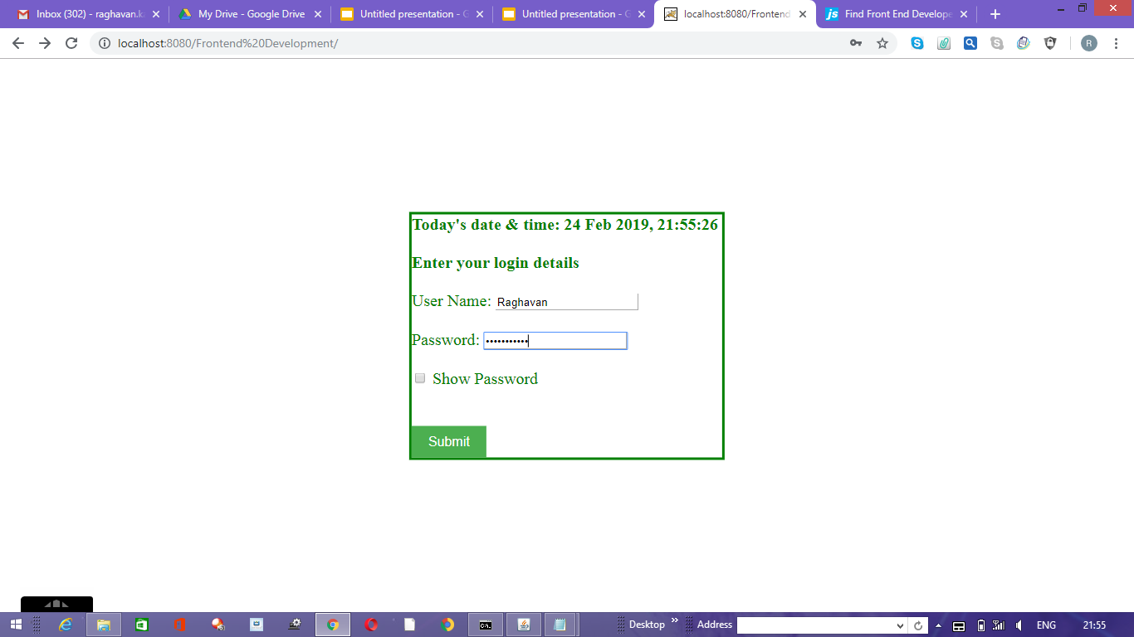
Login Page

Slide 4

Toggle Password by clicking Show Password

Slide 5
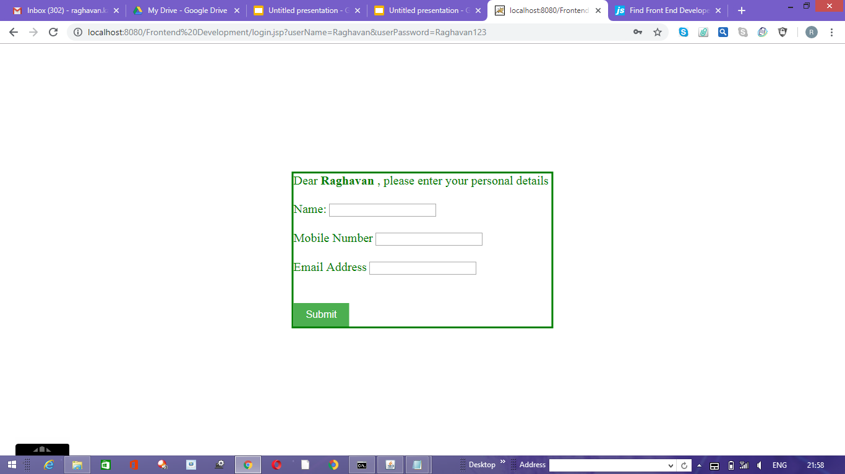
Enter Personal Details screen

